Slide 1
Systems Programming
Dr. B
CS 392 Systems Programming
Spring 2020

Slide 2
About this Course
CS 392: Systems Programming
Instructor: Dr. B
Meeting times:
Section A: 11:00 - 11:50 AM, Gateway South 216
Section B: 12:00 - 12:50 PM, Gateway South 216
Course website: https://sit.instructure.com/courses/36145
Syllabus: https://sit.instructure.com/courses/36145/files/5718593

Slide 3
Office Hours
Office: 430 Gateway South
Office Hours:
M 4 - 5 P.M., TW 5 - 6 P.M., and by appointment
Email: bborowsk@stevens.edu
Phone: 201-216-5358

Slide 4
Computer Systems
Computer system
The complete computer made up of the CPU, memory and related electronics (main cabinet), all the peripheral devices connected to it and its operating system
Operating system
A software system that manages computer hardware and software resources and provides common services for computer programs

Slide 5
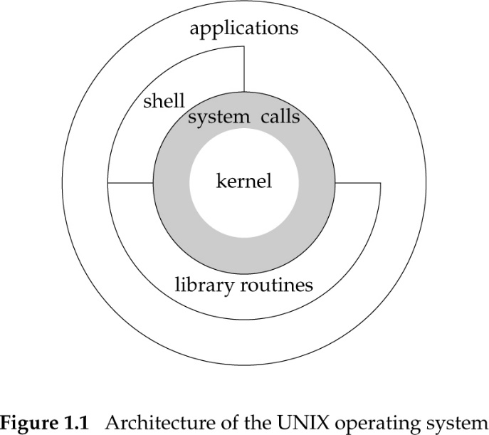
OS vs Kernel
The kernel is the central component of most computer operating systems. It is responsible for managing the hardware and offering services to applications that wish to use it.
Sometimes the OS is used to refer to the kernel.
Sometimes a kernel’s name is used to refer to the whole OS.
Example: Linux is the kernel of the GNU/Linux OS, frequently referred to simply as Linux.

Slide 6

Systems Programming
Programming all kind of computer systems but…
Most commonly refers to programming the operating system
Viewed more broadly and OS includes applications, shells, libraries, utilities, and the kernel
No kernel-level programming in this course
Start coding in BASH
Then code in C
Transition to C programming using the kernel’s APIs on Linux, a UNIX-type OS

Slide 7
Programming: Before vs Now
Before
# Python code
import sys
print('Hello, world!')
// Java Code
public class HelloWorld {
public static void main(String[] args) {
System.out.println("Hello, world");
}
}
// C Code
#include <stdio.h>
int main(void) {
printf("Hello, world\n");
return 0;
}
Now
# Python
def print(args):
…
…
…
// Java
void System.out.println(var_args) {
…
…
…
}
// C Code
int printf(const char *
format, ... ) {
…
…
}

Slide 8
What Is UNIX?
Unix is an operating system (OS). It stands for Unics for Uniplexed Information and Computing Service.
Developed in 1969-1970 by Kenneth Thompson, Dennis Ritchie, and others at Bell Labs
Developed on a PDP-7 (PDP stands for Programmed Data Processor)
Based on the MULTICS OS (Multiplexed Information and Computing Service)
Early versions of UNIX were written in assembly language.
Version 4 of Unix, developed in 1973, was the first OS to be written in C.

Slide 9
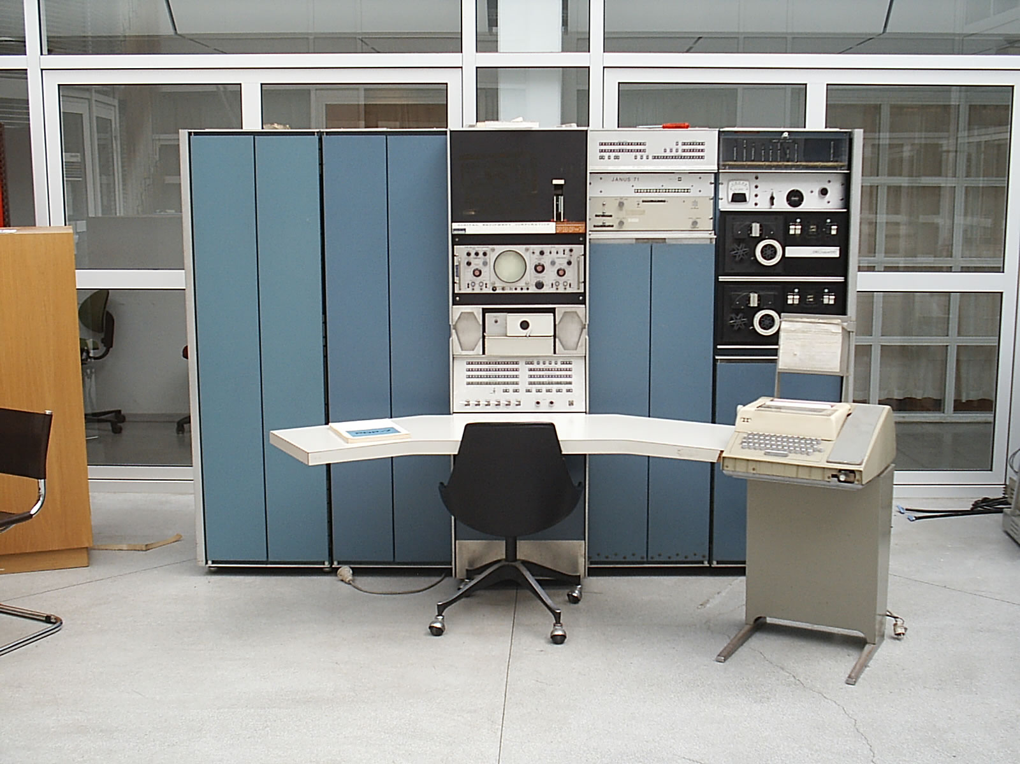
PDP-7

Slide 10
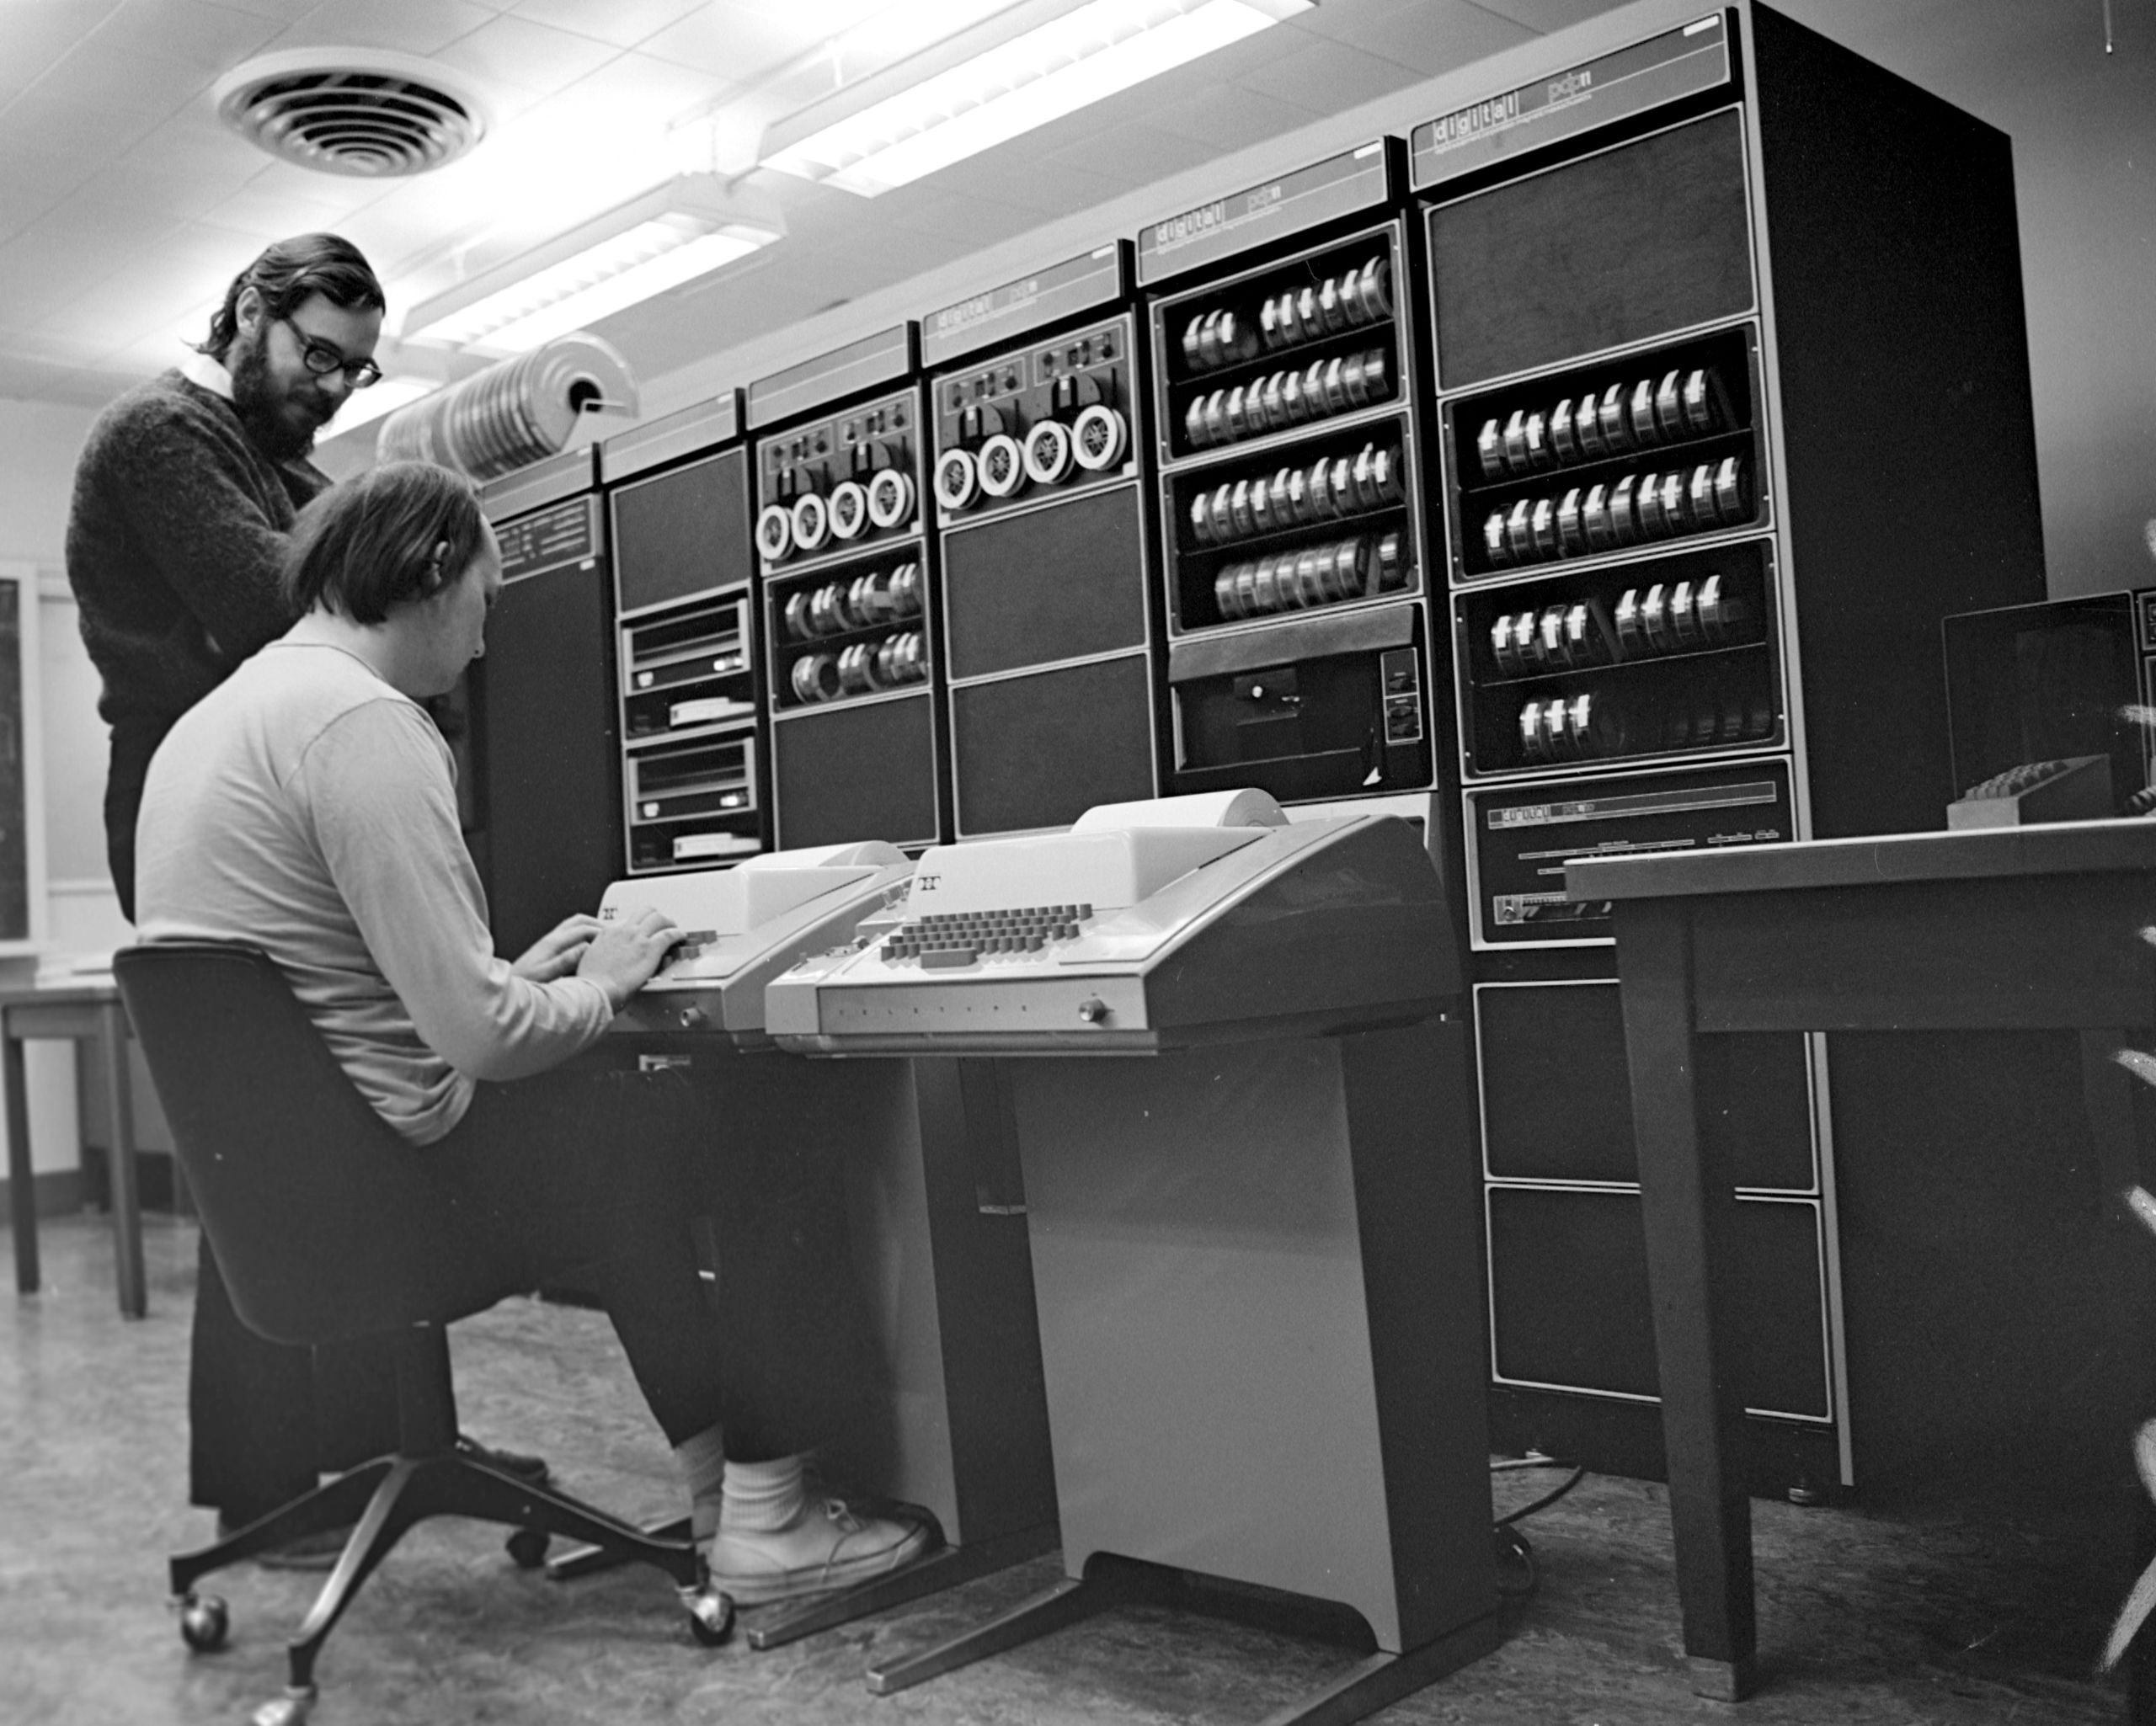
Early Work Leading to UNIX
Ken Thompson was hired by Bell Labs in 1966.
In the 1960s at Bell Labs, Thompson and Dennis Ritchie worked on the Multics operating system.
Frustrated by the complexity of the project, researchers withdrew from the project.
Thompson also created a video game called Space Travel, originally for the GE 635 computer. Since it did not run well on that system, Thompson found an old PDP-7 machine and rewrote Space Travel on it.
As he ported the code, he implemented his own base code libraries.
Eventually, the tools developed by Thompson became the Unix operating system.

Slide 11
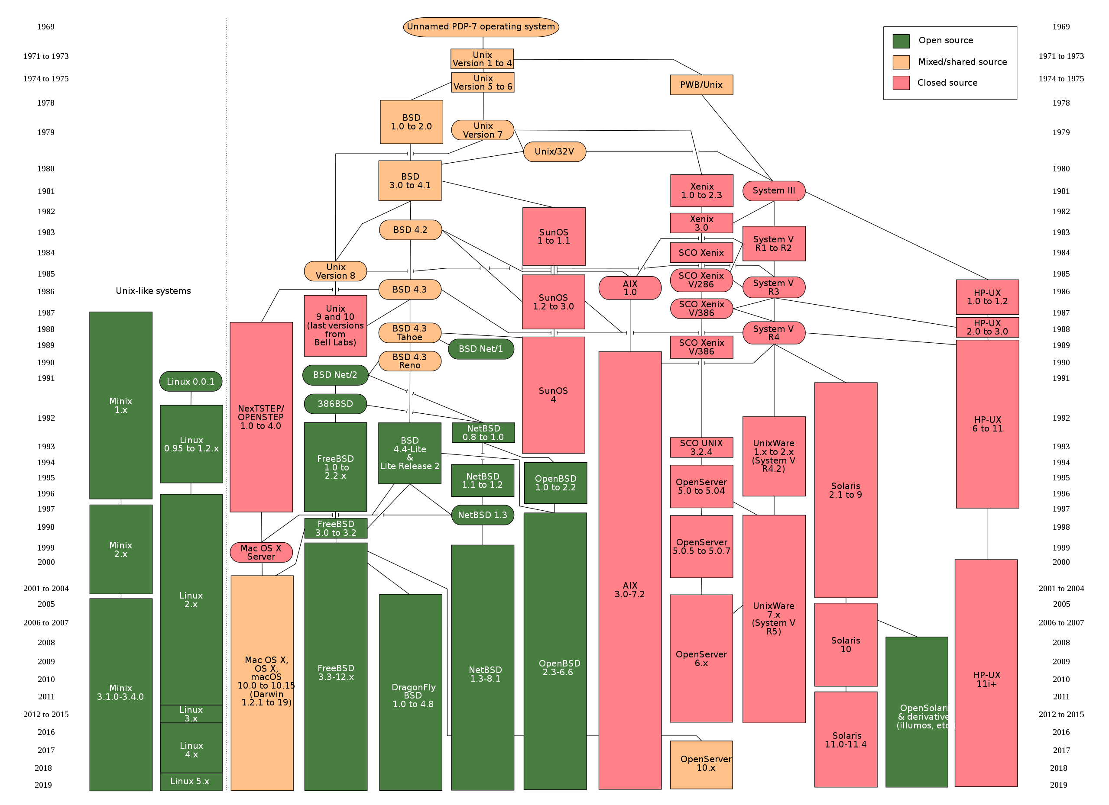

Slide 12
Next: Setting up the VM
We are going to use the same 19.04 lubuntu image used in CS 385 this past fall. The link is available in Canvas.
All of us – the instructor, CAs, and you will use this image.
Your work should be developed and tested in lubuntu, and we will grade your work in the same environment you tested it on.

